Slide 1









My Number Interactive Workbook
$$×$$
$$\frac{1}{2}$$
$$÷$$
$$+$$
$$−$$
$$\frac{3}{5}$$
$$7$$
Name
Class
Teacher
Term 1 Semester 1
$$5^{2}$$
$$\sqrt{9}$$
1

Slide 2
Contents
Glossary or Formula Page
Page
Date
Description
2
3

Slide 3
Tasks
24
7
30
Essential Question
Questions
Notes
Summary

Slide 4
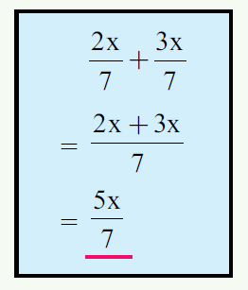
24
7
30
Date
Adding and Subtracting Algebraic Fractions
EQ – What is the difference between adding and subtracting algebraic fractions and normal fractions?
What do I need to do when adding and subtracting fractions?
When adding or subtracting normal numeric fractions we need to ensure we have the same value as the denominator for both fractions. We do exactly the same when adding or subtracting algebraic fractions.
Example
Denominator is the same
Collect the like terms
Simplify if possible

Slide 5

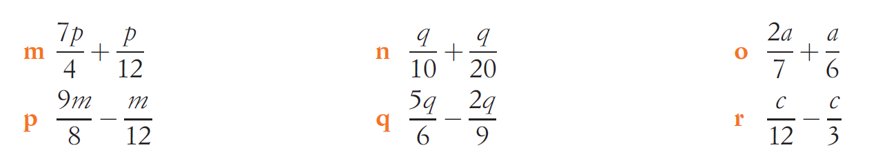
Task
Complete page 8 from the Dwyer textbook.
Extension:
Try these:

Slide 6
Notes Review
24, 7 ,30
Date
Title
Essential question
Notes complete
Notes complete with colour and diagrams
Questions completed
Contents page filled in
Formula page filled in

Slide 7
Homework
Review your notes and write a summary answering the essential question.

